Slide 1
Design Thinking
Topic：
Generative Artificial Intelligence

Slide 2
Group Members
Matric No Name
A23MJ4019 Bu Guoshun
A23MJ4022 Liu Ruoyang
A23MJ4016 Liu Wanpeng
A23MJ4018 Zhao Wei
Date：1/24/2025

Slide 3
Progress​
Introduction
An overview of the design thinking process
Empathy
Definition
Ideate
Prototype
Test
Summary

Slide 4

Introduction
The emergence of generative artificial intelligence (generative AI) has opened doors for innovative applications in diverse fields, providing new ways to create content, solve problems, and boost productivity. This report applies the design thinking process to explore how generative AI can address the needs of ordinary users, focusing on collaboration, innovation, and practical implementation.

Slide 5
Detailed steps
Empathy: Clearly defined personas and responses to user challenges
Define: Problems identified (handling information, time management, personalization) and possible solutions outlined.
Ideate: Brainstorming process with diverse ideas listed and top ideas selected for exploration
Prototype: A platform named "GeneratElite" is described with features such as study plans, image searches, and translation assistance
Test: Testing methods for UI, functionality, and system performance are detailed, ensuring a thorough evaluation.

Slide 6
Empathy
Create three specific user profiles that show how to understand requirements from the user's perspective:
University Student
Challenges: Lots of academic material, high quality writing requirements, difficult time management AI solutions: Summary generator, writing assistant, study plan generation tool
Small Business Owner
Challenges: Difficulty in marketing content production, lack of technical competence AI solutions: automated marketing assistant, user-friendly interface
Graphic Designer
Challenges: Design efficiency, customer compliance, repetitive tasks AI solutions: Design suggestion generation, automated sizing

Slide 7
Define
Goal:
Define actionable solutions for each problem, such as tailored AI tools and accessible platforms.
Core issues
Low information processing efficiency：
Users find it challenging to manage and comprehend large amounts of data.
Lack of personalized content：
Marketing and design outputs often fail to meet individual needs.
Non-technical users have low adaptability to the tool：
Many AI tools are not user-friendly for individuals without technical expertise.
Data privacy and ethical issues：
Users worry about data security and bias in AI-generated content.

Slide 8
Ideate
We conducted an extensive brainstorming session to generate diverse and creative ideas. The goal is to explore the full range of possibilities associated with generative AI, including problems to be solved, potential solutions, creative use cases, and what-if scenarios.
Idea | Description
Real-Time Academic Assistants | AI that provides real-time problem solving based on classroom lectures or learning materials.
Virtual Event Managers | AI handling event logistics, such as scheduling, attendee management, and real-time updates.
Customer Sentiment Analyzers | AI that analyzes customer feedback and suggests actionable improvements

Slide 9
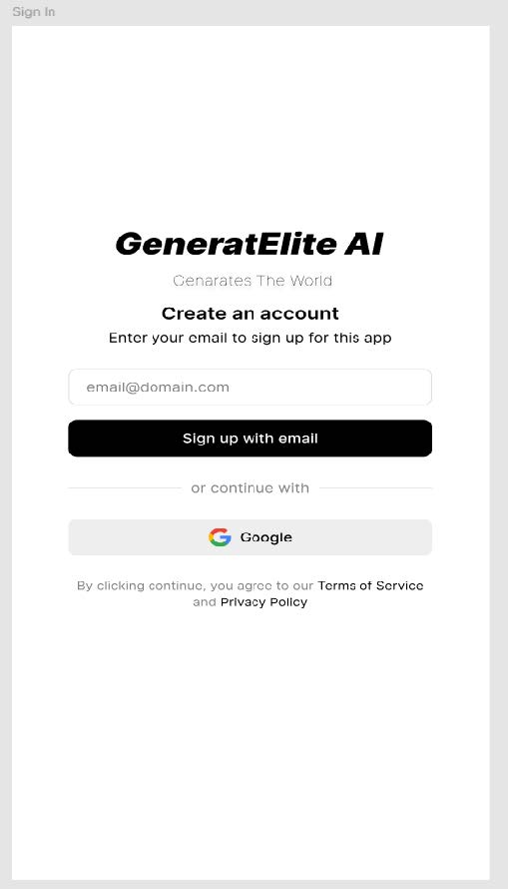
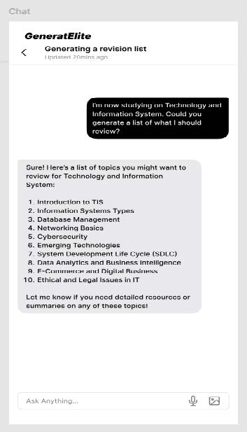
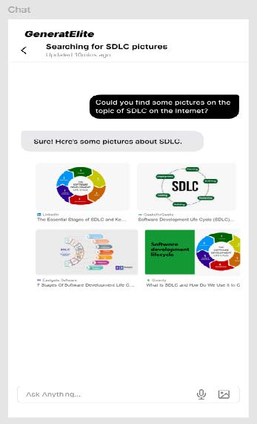
Prototype
We used Figma to manage the User Interface design and create some situations as the storyboard, or to say prototype, of a generative AI. We named it “GeneratElite” which takes “generate” and “elite” as the features. We hope it can be an elite in generative AI field.
Sign Up/Sign In Page
Learning plan page
Translator page

Slide 10
Testing
Objective: Validate the functionality, user experience, and performance of GeneratElite AI platform.
Key Testing Areas:
User Interface (UI) & User Experience (UX):
Navigation is intuitive and compatible across devices.
AI Response Accuracy:
Accurate Revision List Generation and Translation Assistance.
System Performance:
Fast response time and stable under multi-user tests.
Feature-Specific Functionality:
Consistent and accurate Image Search results.

Slide 11

Summary
Through a design thinking approach, the team analyzed user needs in depth, proposed specific AI solutions, and verified the feasibility of the concept through prototype development and testing. This shows that generative AI has a wide range of potential applications in fields such as education, business, and design.

Slide 12
THANKs！！！

